Slide 1
OHS SCIENCE FAIR EXPO 2016
OAKLEAF HIGH SCHOOL

Slide 2
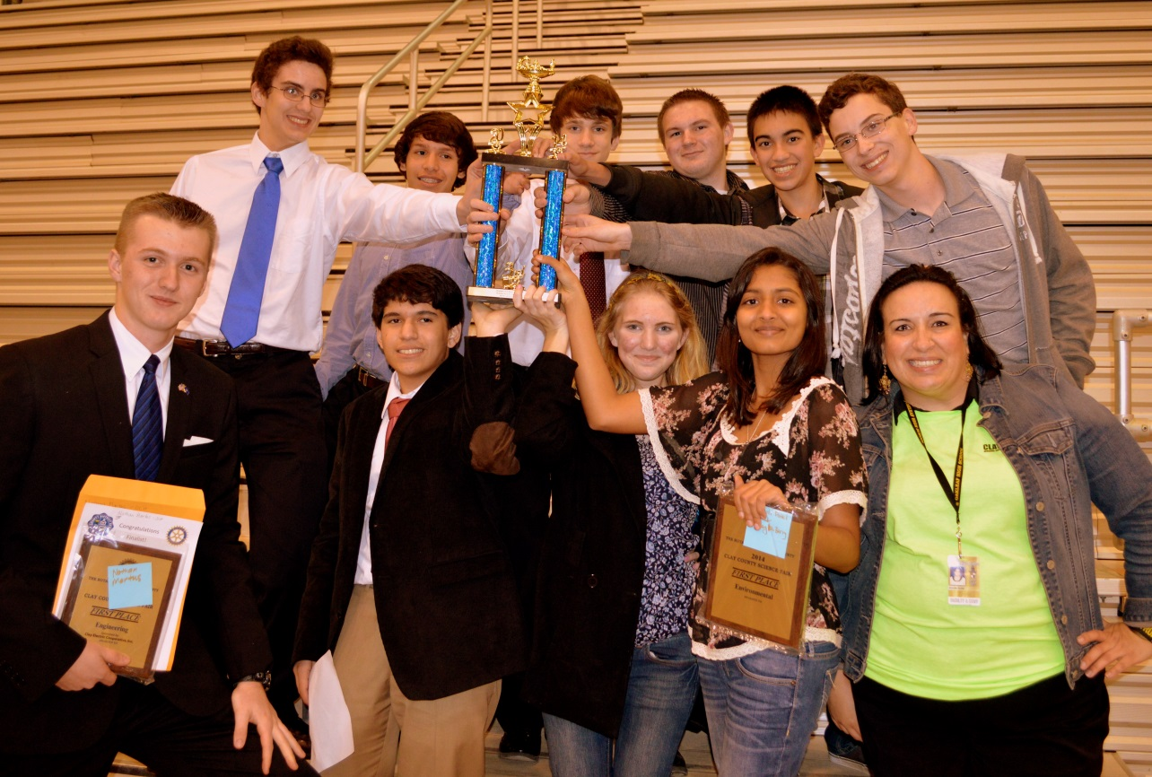
SCIENCE FAIR ROCKS!!!

Slide 3
Science Fair General Timeline
September: Topic Selection & ISEF Forms
October: Research Paper
November: Experimentation & Portfolio
December: Display Board & Final Project Due!
January: COMPETITION TIME! Will you WIN??!! Will you go to DISTRICTS? STATE? INTERNATIONALS??!! #YES ☺

Slide 4
What to do…what NOT to do…
EXAMPLE! “White House Fair” Click below ☺
https://www.youtube.com/watch?feature=player_embedded&v=7w3sTfiNis0
NONEXAMPLE! “Cup of Dirt” Click below ☹
https://www.youtube.com/watch?feature=player_embedded&v=I1fat8MiDVM

Slide 5
The MOST important thing…TOPIC SELECTION!
What are you interested in??? Write down 5 topics.
What questions can you come up with regarding those topics? Write 3 questions per topic using ‘question words’.
(Who? What? When? Where? Why? How?)
Are those questions “measureable”? If not, tweak them. A HYPOTHESIS must be TESTABLE! (Don’t come up with just a ‘research’ or ‘yes/no’ questions? ie. “Is the moon made of cheese? Can I build a lava volcano?)
Things that can be tested…height, width, length, mass, density, buoyancy, rate, temperature, speed, distance, volume, change in color, quantity, etc.
Are those questions “on grade level”? If not, tweak them. Basically, if an 8th grader can do it, choose something else!
Which of your questions have the greatest PRACTICAL APPLICATION and/or MEAN THE MOST TO YOU???!!!
Is that question “unique”? How did you Make It Your Own?
In other words, if it’s a ‘common project’, what did you change to make it unique? How did you tweak it? What are your independent and dependent variables? What are your controlled conditions? How does this experimentation differ from the ‘original/common’ one? (M.I.Y.O (mee’yo): “mio” in Spanish means MINE! ☺)

Slide 6
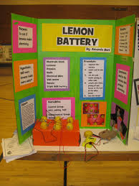
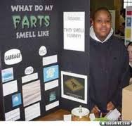
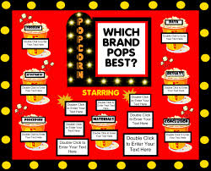
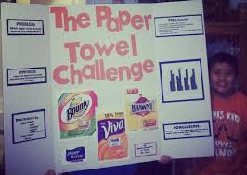
Kid: Uh, can I do this? Teacher: NOOO!!!

Slide 7
TOPIC SELECTION …EPIC FAIL??!!
ABSOLUTE NO-NO’S…
INGESTION…(nope…NOTHING in the mouth…not even water!)
MOLD…(no! growing mold is not a good project. You can’t collect great data without going against ISEF rules!)
MAYBE’S…SEE MISS BUTLER ASAP…EXTRA FORMS & S.R.C. APPROVAL REQUIRED!
FIRE…(it better be AMAZING if ya’ wanna work with fire…is fire necessary?)
BALLISTICS…(only for INCREDIBLE ideas; TONS of paperwork & hoops to jump through!)
VERTEBRATE ANIMALS…(ANYTHING with a backbone! Is project necessary? Will it alter the animal’s environment? Will you have a good sample size? Need vet approval!)
MICROORGANISMS…(needs to be in proper environment with an EXPERT scientist (phD)!)
RISK ASSESSMENT…(if working with ANY tool or chemical…need Form 3 AND SDS Sheet on Chemical and safety precautions for tools)
HUMAN SUBJECTS…(GENERAL SURVEYS must be THOROUGHLY REVIEWED prior to experiment Ms. Butler…IF participating IN an experiment, need Form 4 & Consent Form!!!!)
RESEARCH FACILITY…(if working in an institution, need Form 1C)

Slide 8
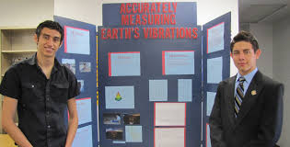
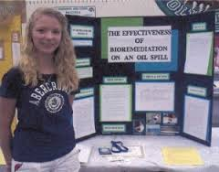
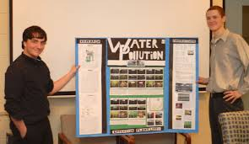
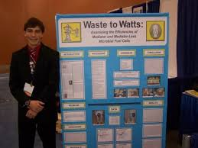
Kid: How about this? Teacher: Now we’re on track!

Slide 9
TOPIC SELECTION DATES
This Powerpoint was discussed: 9/16/15
Media Center Class Time: 9/_/15
Students pick Group Members
Students search for Topic using book and computer resources
One-on-one time with Miss Butler for guidance
FINALIZE GROUP MEMBERS & TOP 3 TOPIC CHOICES! Must complete topic selection forms & turn in to Miss Butler by TUESDAY, SEPTEMBER 22nd!

