Slide 1
How to Take Cornell Notes
Excellent Cornell notes contribute to student success.
It is a research-based strategy taken from Cornell University and one of the most successful ways to improve student learning.

Slide 2
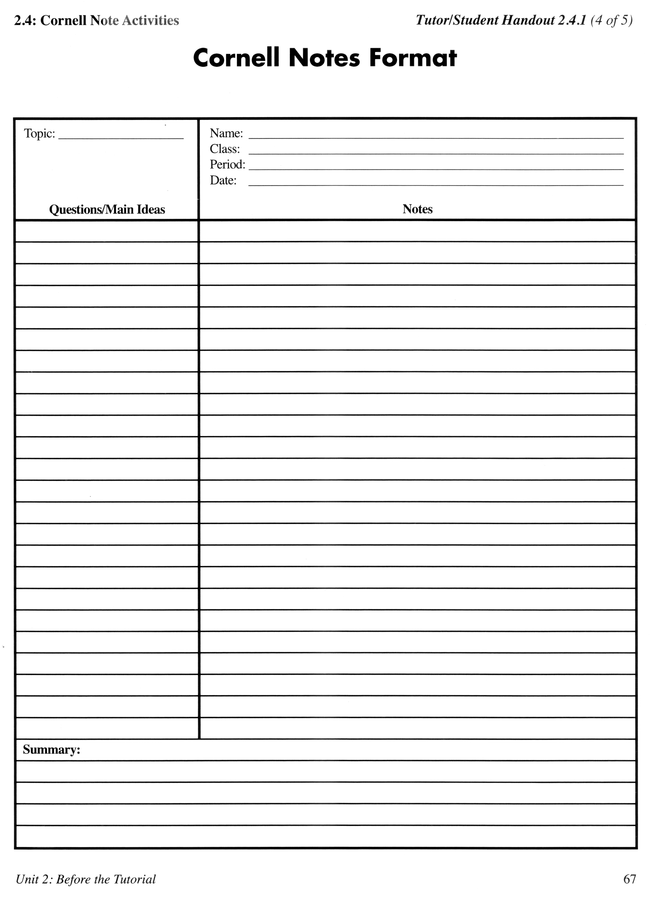
Topic
Cornell Notes Format
  .
Notes:
The box with the Name, Class, Period, and Date is the Header.

Slide 3
What’s the advantage of using Cornell notes?
A way to master information, not just write down facts.
It’s efficient.
Each step helps you in the learning process.

Slide 4
Where will you take cornell notes?
You will use your composition notebook for all of your biology notes.
You will be responsible for setting up the Cornell format within the pages of your composition book
Notes:
The box with the Name, Class, Period, and Date is the Header.

Slide 5
Questions/Main Ideas
Cornell Notes Format

Slide 6
How do you take notes during class?
Try to get the MAIN IDEAS down. Facts, details and examples must have the main idea if they are to be meaningful.
Don’t try to outline, but use obvious numbers when given. First, second, next, 1, 2, 3, etc.
Abbreviate to save time.
Draw diagrams, pictures, or use graphic organizers (KWL chart, web map, etc.) to help you.
Skip lines to separate different blocks of information like a different word.

Slide 7
Notes
Cornell Notes Format
  .
Notes:
The box with the Name, Class, Period, and Date is the Header.

Slide 8
How do I make my notes more useful?
Read notes and underline key words or phrases.
Correct or enhance incomplete items: loose dates, terms, names, add more to notes that are too brief to know what they are about in a few months.

Slide 9
How do I use them to study?
Write questions in the left-hand column about the information on the right.
Write a summary, at least 1 sentence for each page, at the bottom of the referring to the notes on that page. Or, you may write a 4 sentence summary for each section of the chapter.
Compare your notes with a study buddy.

Slide 10
Summary
Summary:

Slide 11
How do I use my notes to prepare for a test?
Cover the big box on the right. Read your questions from the left column. Recite the information from memory as fully as possible. Uncover your notes and verify information each time. (Researched as the single most powerful learning tool!)
Reflect on the organization of all the lectures on a unit. Study the progression of information. Compare your notes from each lecture. (This will prompt you to think of categories, relationships inferences, and personal opinions/experiences.) Write down your insights! REFLECTION = THE KEY TO MEMORY!!
Review by reciting, reflecting, and reading insights.

Slide 12
6 Steps!!!
Record notes in big box.
Read over notes to fill in gaps and make notes more legible within 8 hours,
Identify main ideas and write your questions in the left-hand column.
Cover the big box: use your questions to help you recite the information recorded in your notes, and verify.
Write a summary at the bottom of the page at least 4 sentences. Include the main idea and the details.
Keep your notes. Review your notes regularly. Short, fast, frequent reviews produce better understanding and recall.
Six Steps

