Slide 1
Chapter 23
Plant Structure and Function

Slide 2
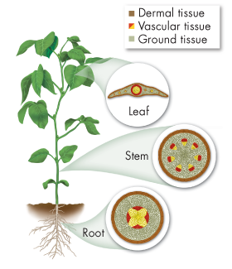
Seed Plant Structure
23.1
Roots
Anchor
Absorb water and nutrients
Store food
Stems
Structural support
Transport nutrients and water
Defense (from predators & disease)
Leaves
Photosynthesis
Gas exchange (CO₂ and O₂)

Slide 3
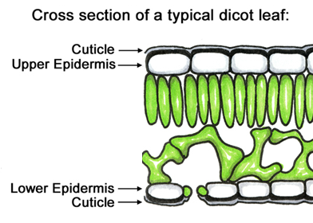
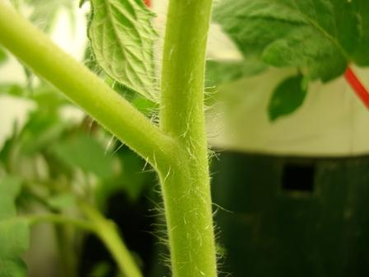
Plant Tissue Systems: Dermal
23.1
Protective outer layer or “skin”
Epidermis is the outermost layer of cells
Often covered with thick waxy layer (cuticle) to prevent water loss
Sometimes covered in tiny projections (trichomes) for projection
Give “fuzzy” appearance
Sometimes covered in bark or root hairs

Slide 4
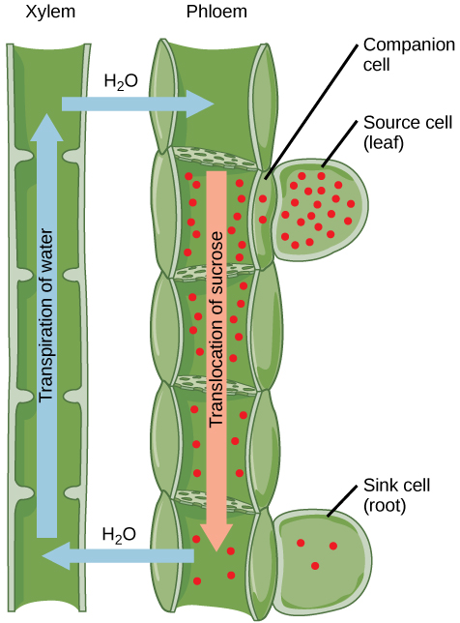
Plant Tissue Systems: Vascular
23.1
Supports plant and transports water & nutrients
2 types:
Xylem (water transport)
Phloem (nutrient transport)
Both are long, narrow cells that die and leave behind hollow “pipes”

Slide 5
Plant Tissue Systems: Ground
23.1
All other tissue
Produces & stores sugars, adds physical support
Edible portion of most plants
3 types:
Parenchyma (thin cell walls)
Most common
Leaves and more
Collenchyma (thicker walls)
Ex: celery
Sclerenchyma (thickest walls)
Strong fibers for rope, etc.
Ex: seeds

Slide 6
Plant Tissue Systems Recap
23.1

Slide 7
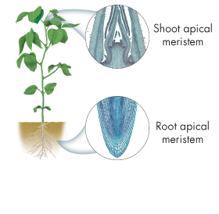
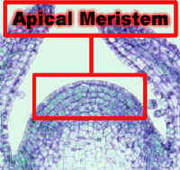
Plant Growth
23.1
Meristems are regions of plant growth
Mitosis produces undifferentiated cells here
Similar to stem cells in animals
These cells eventually differentiate into various tissue types
Apical meristems are found at the tip of roots or stems
Meristems also important for plant reproduction
Floral meristems

Slide 8
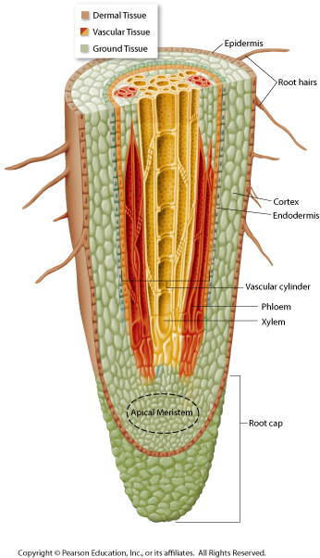
Roots
23.2
Dermal Tissue (epidermis): protection and absorption
Covered in root hairs to increase surface area
Ground tissue: stores starch
Vascular tissue: xylem and phloem form a central vascular cylinder
Meristem tissue: roots grow the most at the apical meristem
Root cap protects the meristem as it pushes through the soil

Slide 9
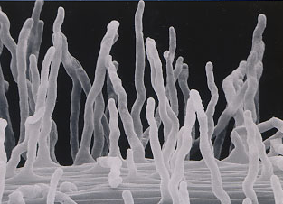
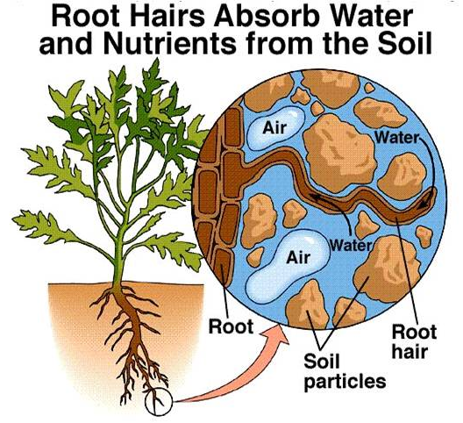
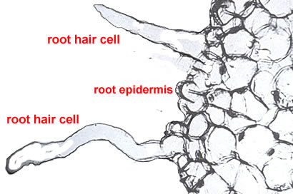
Root Hairs
23.2

Slide 10
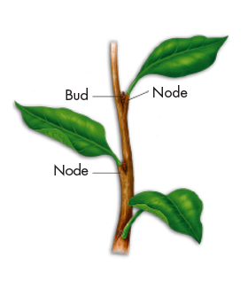
Stems
23.3
Provide support
Transport substances throughout the plant (xylem and phloem)
Leaves are attached to the stem at nodes
Buds at nodes contain apical meristems that can produce new stems and leaves

Slide 11
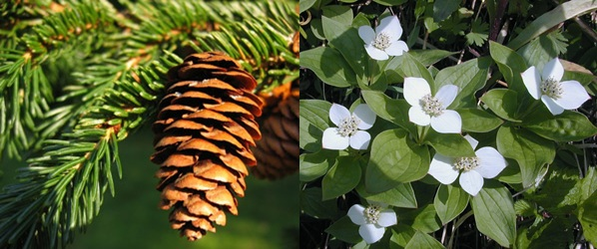
Gymnosperms Angiosperms
23.3
A.K.A. Conifers
Non-flowering
Seeds in cones
Flowering plants

Slide 12
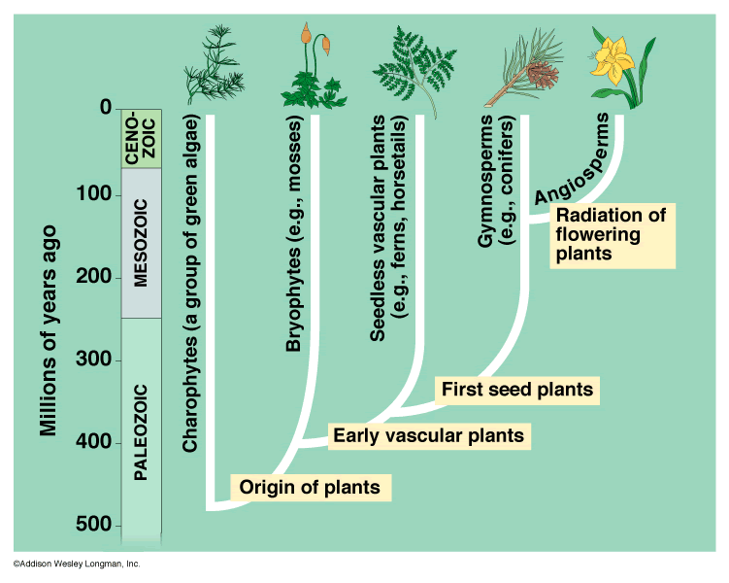
Plant Phylogeny
23.3

Slide 13
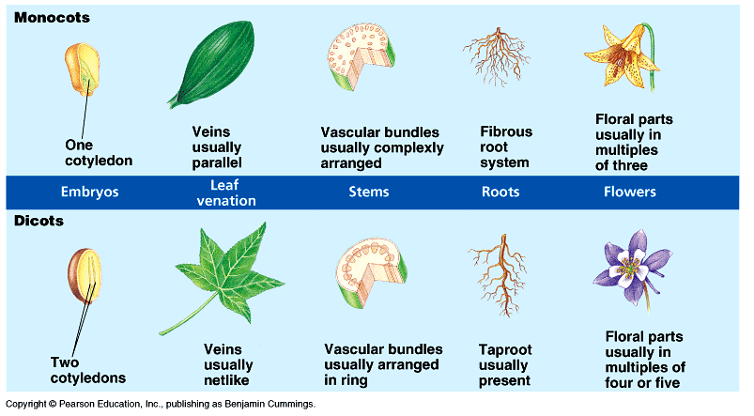
Types of Angiosperms
23.3

Slide 14
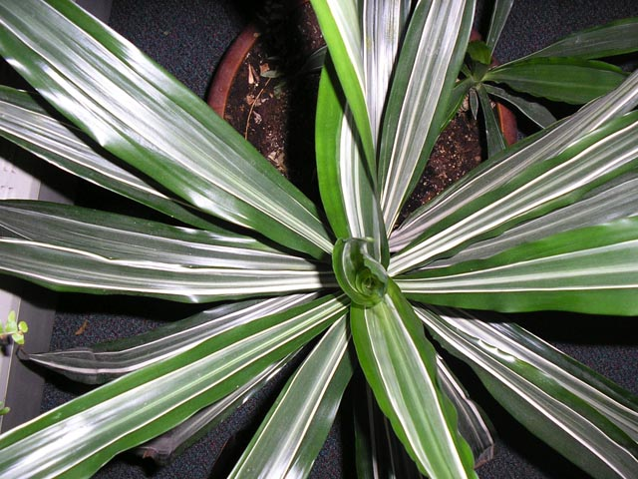
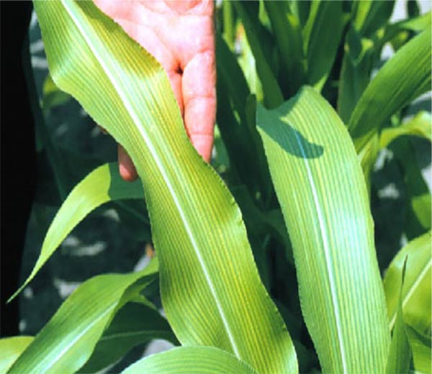
Monocots
23.3

Slide 15
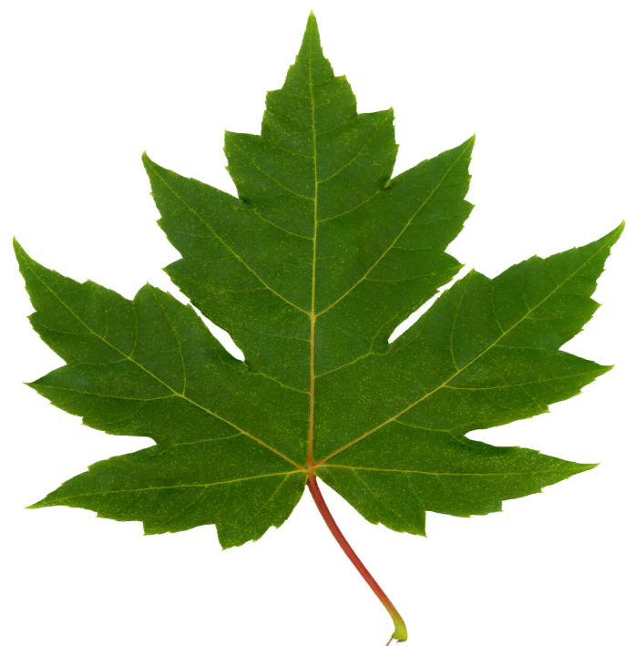
Dicots
23.3

Slide 16
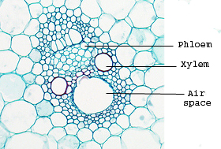
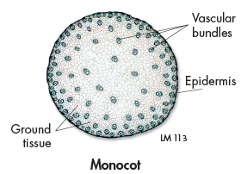
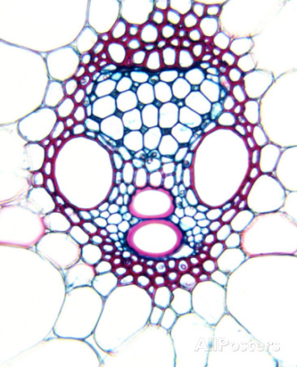
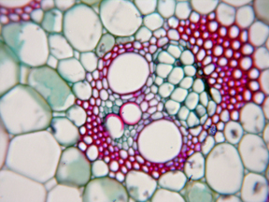
Vascular Bundle Patterns
23.3
In monocots: clusters of xylem and phloem tissue, called vascular bundles, are scattered throughout the stem

Slide 17
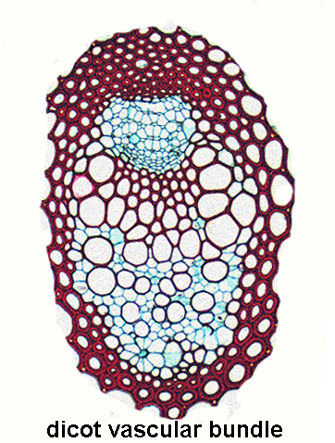
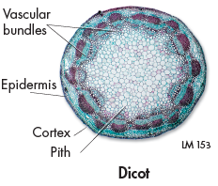
Vascular Bundle Patterns
23.3
In most dicots and gymnosperms, vascular bundles are arranged in a cylinder, or ring

Slide 18
Vascular Bundle Patterns
23.3

Slide 19
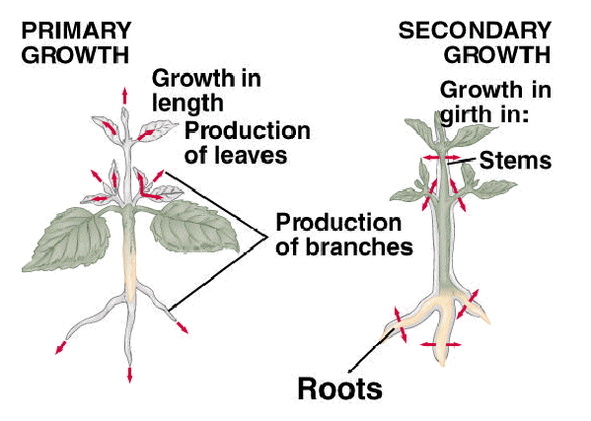
Primary Growth
23.3
Growth occurring at the ends of a plant
From apical meristems
Branches and leaves produced
Plant gets longer/taller

Slide 20
Secondary Growth
23.3
Increased their width
Plant gets thicker
Rare in monocots
Allows dicots to become larger.

Slide 21
Secondary Growth
23.3
Increased their width
Plant gets thicker
Rare in monocots
Allows dicots to become larger than monocots

Slide 22
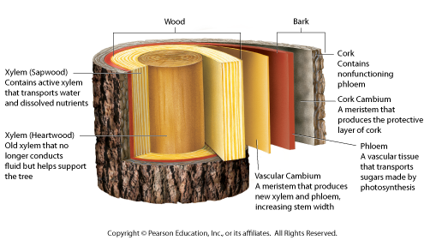
Secondary Growth
23.3

Slide 23
Wood Formation
23.3
Wood = layers of xylem
Vascular cambium produces xylem and phloem
Inner xylem makes up heartwood
No longer conducts water

Slide 24
Wood Formation
23.3
Sapwood surrounds heartwood
Actively transports water
Lighter in color

Slide 25
Bark Formation
23.3
Everything outside the vascular cambium is bark
Includes phloem, cork cambium, and cork
The cork cambium produces a protective layer of waterproof cork
Prevents water loss and protects against disease, etc.

Slide 26
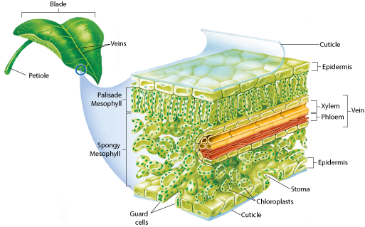
Leaves
23.4
Most have a thin flat blade
Optimized to absorb light

Slide 27
Leaves
23.4
Attached to stem by petiole
Covered by waxy cuticle to prevent water loss

Slide 28
Leaf Vascular Tissue
23.4
Xylem and phloem bundled into veins
Remember: branched in dicots, parallel in monocots

Slide 29
Leaf Ground Tissue
23.4
A.K.A. mesophyll
Site of photosynthesis

Slide 30
Leaf Ground Tissue
23.4
Palisade mesophyll absorbs light
Spongy mesophyll is involved in gas exchange

Slide 31
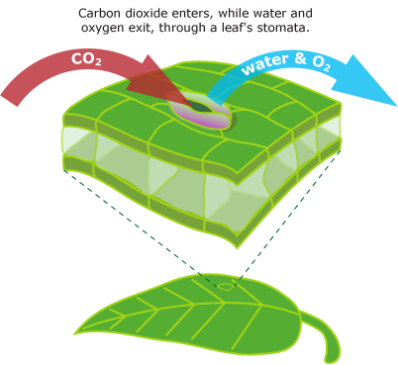
Leaf Ground Tissue
23.4
Stomata (singular: stoma) are openings that allow gases to enter/leave the spongy mesophyll
CO₂ in, H₂O and O₂ out
Guard cells open and close stomata
Close to prevent water loss

Slide 32
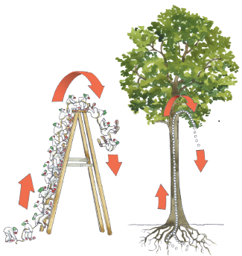
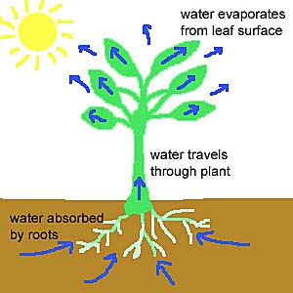
Transpiration
23.5
Water evaporation through open stomata
Water leaving stomata pulls on other water molecules
Cohesion
Helps water rise from roots to leaves

Slide 33
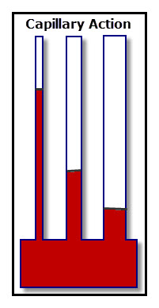
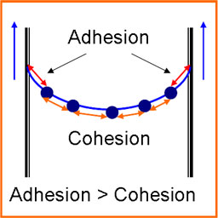
Capillary Action
23.5
Capillary action in xylem also helps water rise (and resist falling back down)
Adhesion to xylem walls
Water to water cohesion
Works best in thin tubes
More adhesion per volume

Slide 34
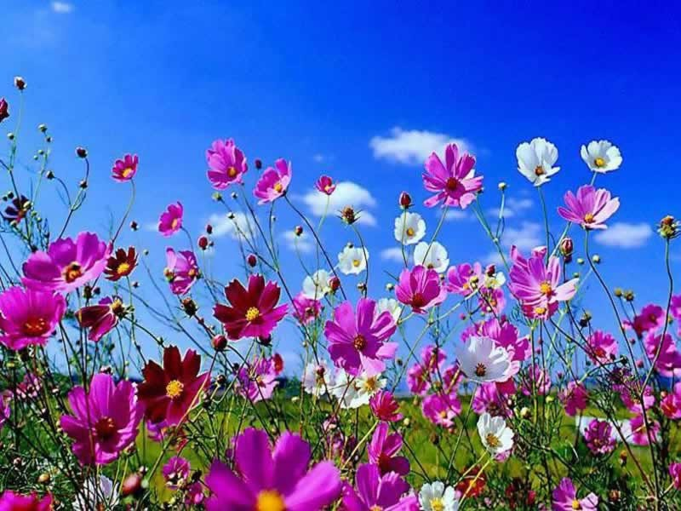
Chapter 24
Plant Reproduction

Slide 35
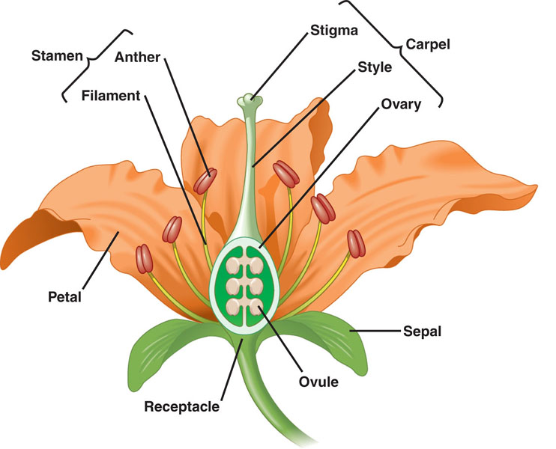
Flower Anatomy
24.1
*All specialized leaves

Slide 36
Sepals and Petals
24.1
Sepals- protect developing flower (usually green)
Petals- attract pollinators (often brightly colored)

Slide 37
Stamen (male parts)
24.1
Anther- produces pollen (sperm)
Filament- supports anther

Slide 38
Carpel (female parts)
24.1
Stigma- sticky landing site for pollen
Style- supports stigma; transports pollen to ovary

Slide 39
Carpel (female parts)
24.1
Ovary- contains ovules (“eggs”)
Will eventually become fruit

Slide 40
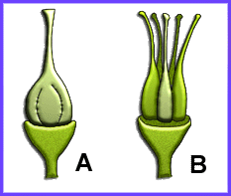
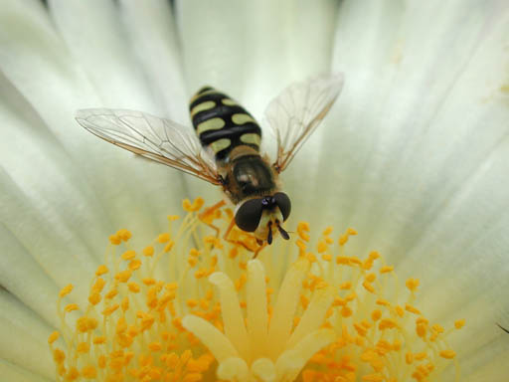
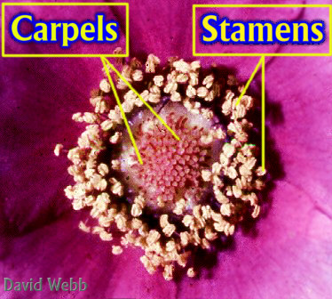
Carpel (female parts)
24.1
Pistil- one or more carpels
Simple pistil = carpel

Slide 41
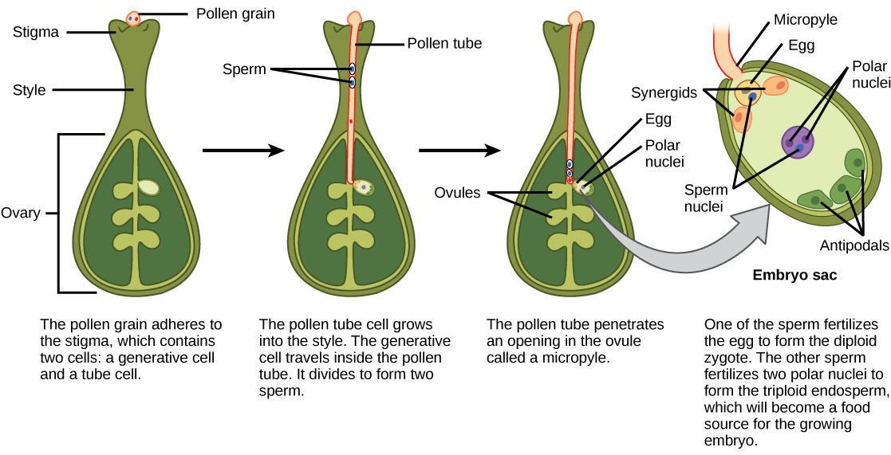
Double Fertilization
24.1

Slide 42
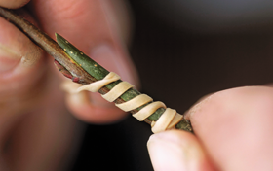
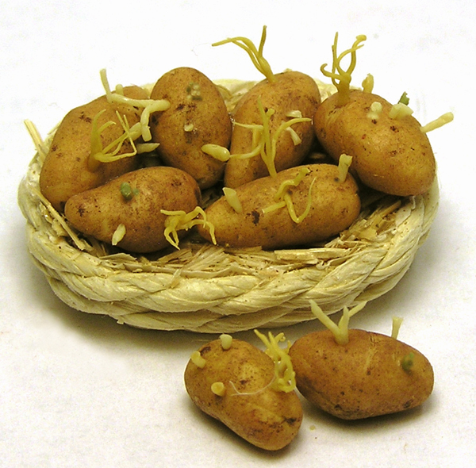
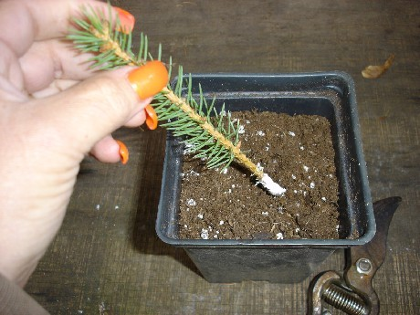
Vegetative Reproduction
24.1
Asexual: mitosis only (no meiosis/gametes)
Budding
Cuttings
Grafting

Slide 43
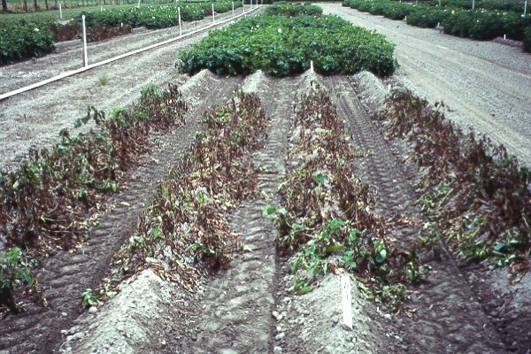
Vegetative Reproduction
24.1
Drawback: lack of genetic variation
All clones of each other

Slide 44
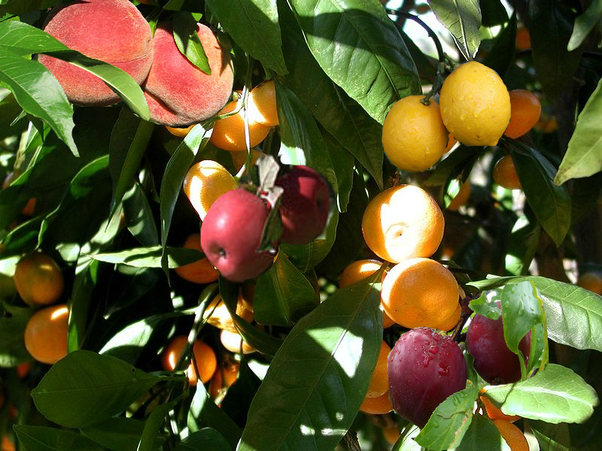
Grafting
24.1

Slide 45
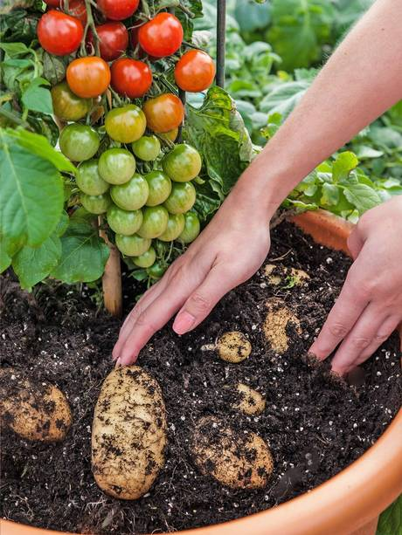
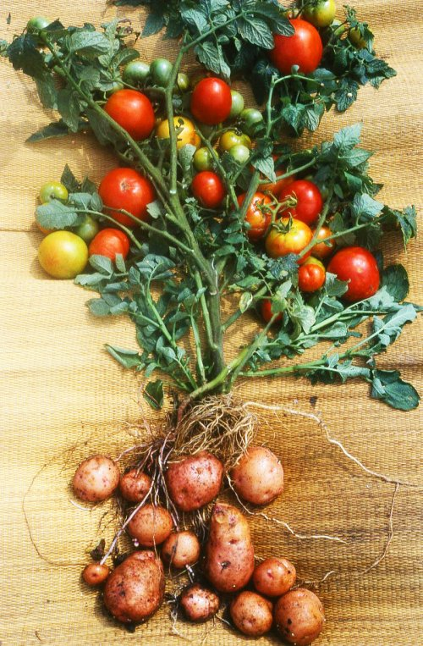
Pomato!
24.1

