Slide 1
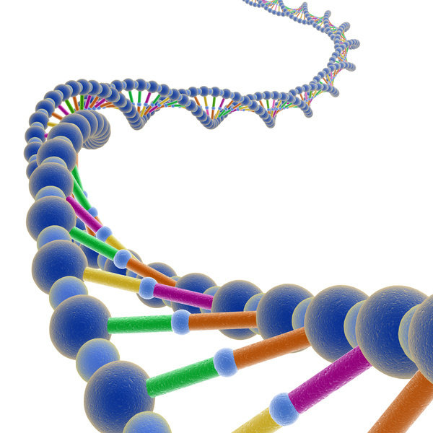
Chapter 12 DNA and RNA

Slide 2
Chapter 12-1: DNA
12-1
Explain the relationship between genes and DNA
Objectives:
Describe the structure of DNA

Slide 3
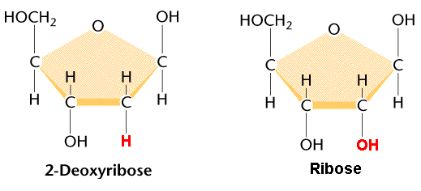
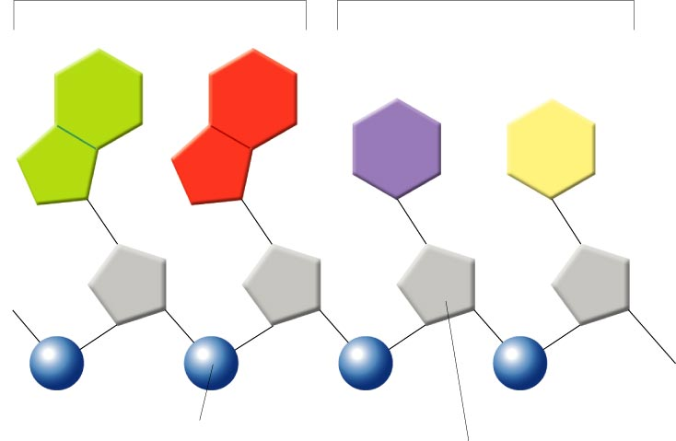
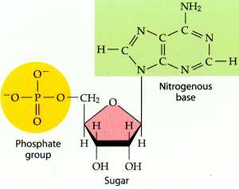
Structure of DNA
12-1
DNA = deoxyribonucleic acid
DNA is a nucleic acid polymer of nucleotides
Nucleotides are made up of a
Deoxyribose sugar
Phosphate group
Nitrogenous base
Nitrogenous base
Nucleotide
Phosphate group
Deoxyribose

Slide 4
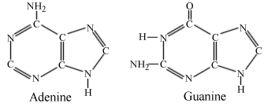
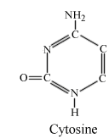
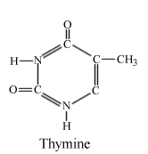
Structure of DNA
12-1
Purines
Pyrimidines
4 nitrogenous bases
2 purines
Adenine
Guanine
2 pyrimidines
Cytosine
Thymine
Purines have two rings in their structure, pyrimidines have one
A
G
C
T
Phosphate group
Deoxyribose

Slide 5
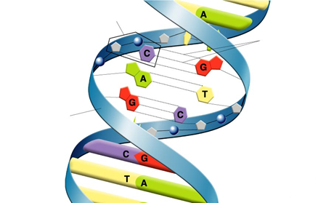
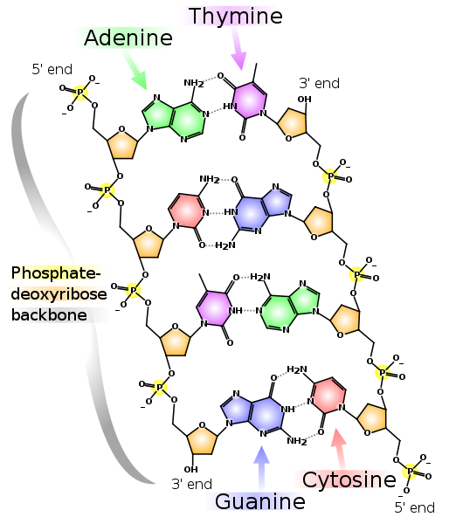
Structure of DNA
12-1
Nucleotide
Hydrogen bonds
DNA is has two strands arranged in a double helix
“twisted ladder”
Sugar-phosphate backbone
Nitrogenous bases are the rungs of the ladder
Strands are held together by hydrogen bonds
Sugar-phosphate backbone

Slide 6
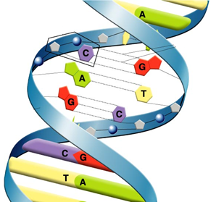
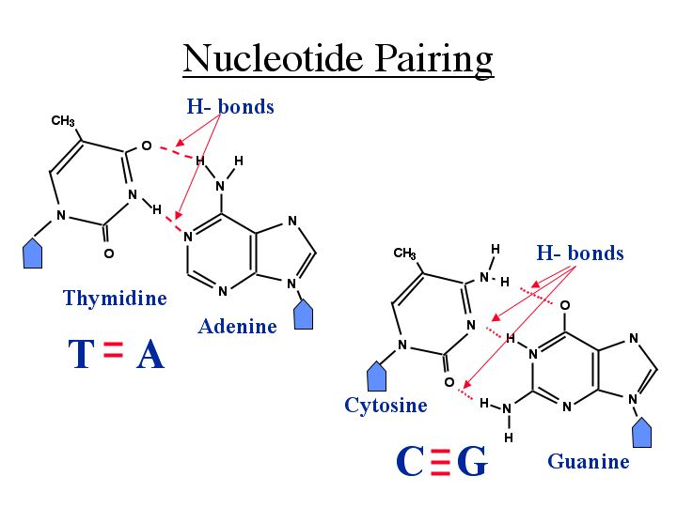
Base Pairing
12-1
Guanine always bonds to Cytosine
G-C
Adenine always bonds to thymine
A-T
Note that each purine has a complimentary pyrimidine
If the sequence of one strand was AAGCTTCGA what would the complimentary be?

Slide 7
Chapter 12-2: Chromosomes and DNA Replication
12-2
Link DNA and chromosomes
Objectives:
Explain the process of DNA replication

Slide 8
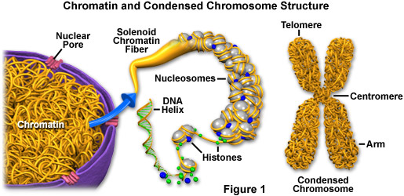
Chromosome Structure
12-2
DNA must be tightly coiled and compressed in order to fit in a cell
A cell’s DNA is ~600,000 times longer than the cell itself!
Chromosomes are made up of chromatin
DNA and proteins called histones
Nucleosomes are spooled units of DNA wrapped around histones

Slide 9
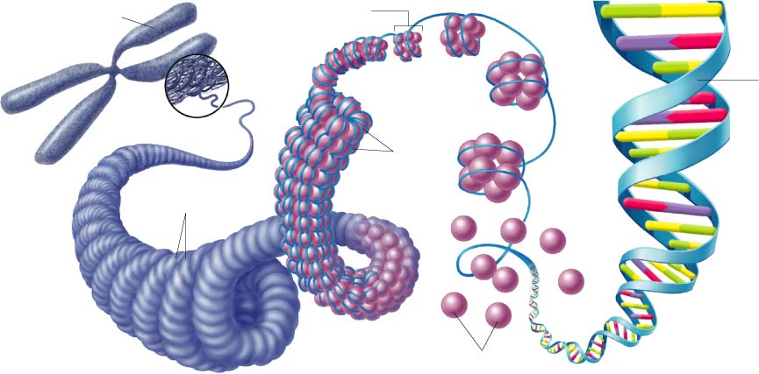
12-2
Chromosome
Nucleosome
DNA
double
helix
Coils
Supercoils
Histones

Slide 10
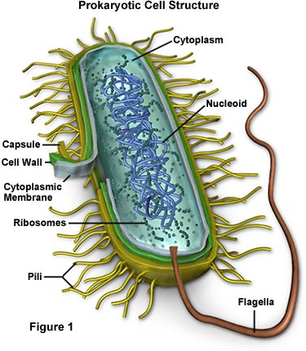
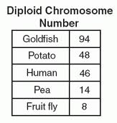
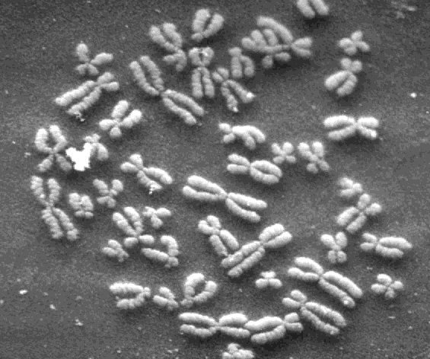
Eukaryotic vs. Prokaryotic Chromosomes
12-2
Prokaryotes have a single chromosome
Eukaryotes have multiple chromosomes
~1000x more DNA than prokaryotes

Slide 11
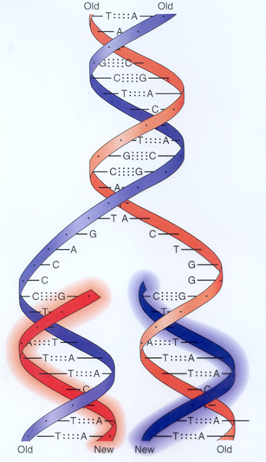
DNA Replication
12-2
Before a cell divides its DNA must be copied in a process called replication
Ensures that each cell has a complete set of DNA
Based on complementary base pairing
The double helix is separated and each strand becomes the template for a new double helix

Slide 12
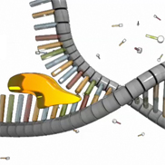
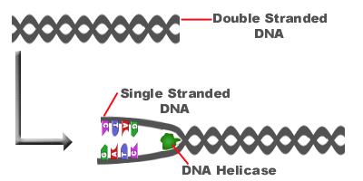
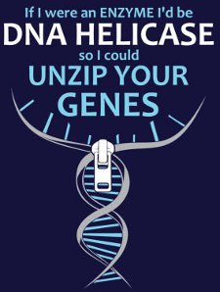
DNA Replication Step 1
12-2
The DNA strand is unzipped by the enzyme DNA helicase
Hydrogen bonds are broken

Slide 13
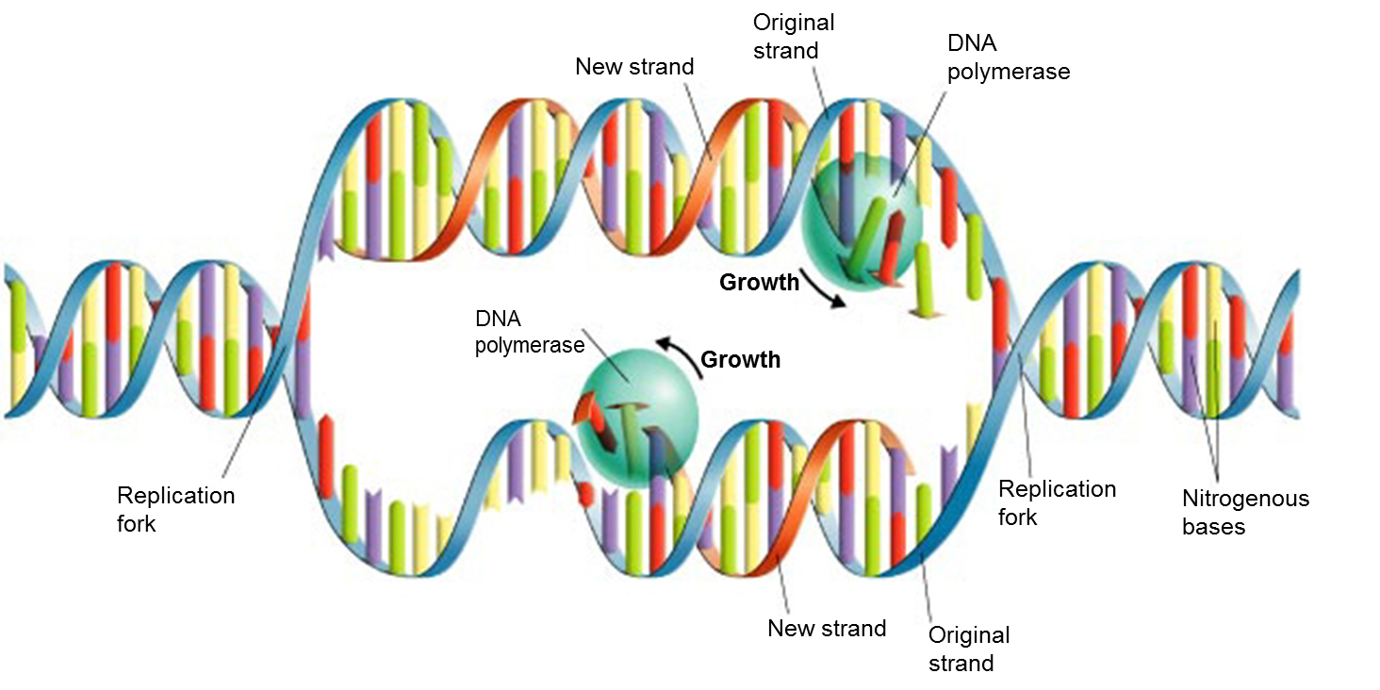
DNA Replication Step 2
12-2
The enzyme DNA polymerase adds complementary nucleotides to the exposed strands

Slide 14
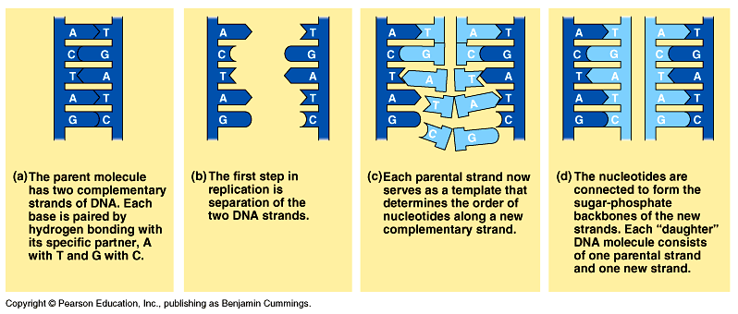
12-2
DNA Replication Summary

Slide 15
Chapter 12-3: RNA and Protein Synthesis
12-3
Compare/contrast RNA and DNA
Objectives:
Describe the 3 types of RNA
Explain the process of transcription
Explain how RNA is used to make proteins

Slide 16
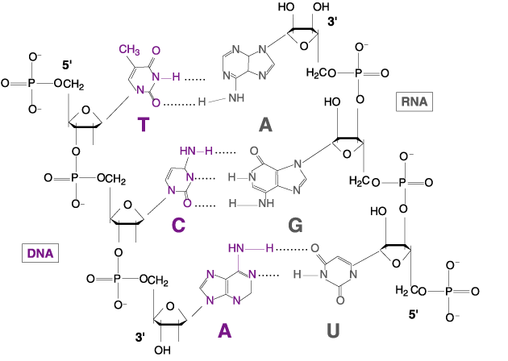
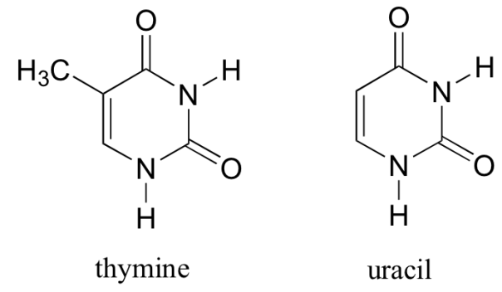
RNA
12-3
Ribonucleic acid
Nucleotide polymer
Single-stranded
Ribose sugar instead of deoxyribose
Nitrogenous bases include:
Adenine
Guanine
Cytosine
Uracil
Usually much shorter
Disposable

Slide 17
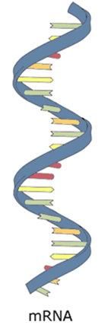
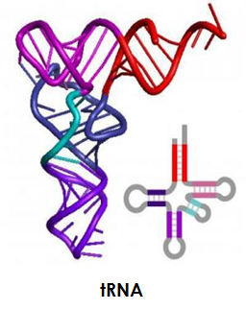
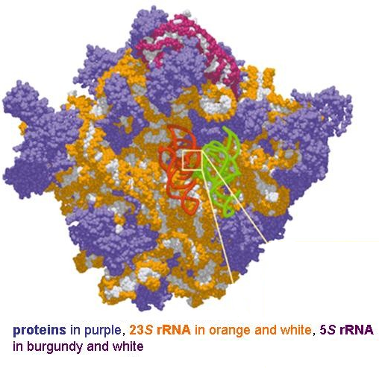
Types of RNA
12-3
3 types
All used during protein sythesis
Messenger RNA (mRNA)
Carries information for making proteins from DNA to ribosomes
Ribosomal RNA (rRNA)
Makes up ribosomes (along with various proteins)
Transfer RNA (tRNA)
Brings amino acids to the ribosome as specified by mRNA

Slide 18
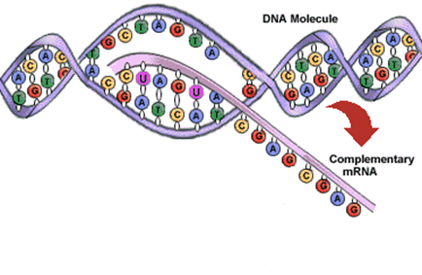
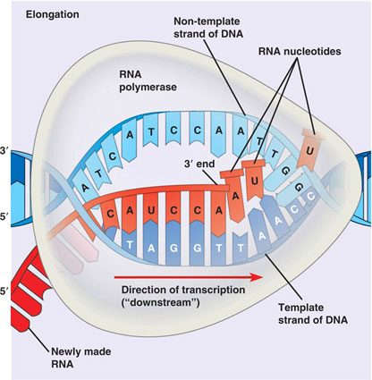
Transcription
12-3
mRNA is made from a segment of DNA
Steps for RNA polymerase:
Binds to DNA at a promoter site
Separates DNA strands
Uses one DNA strand as a template to make a strand of mRNA
Stop signal is reached

Slide 19
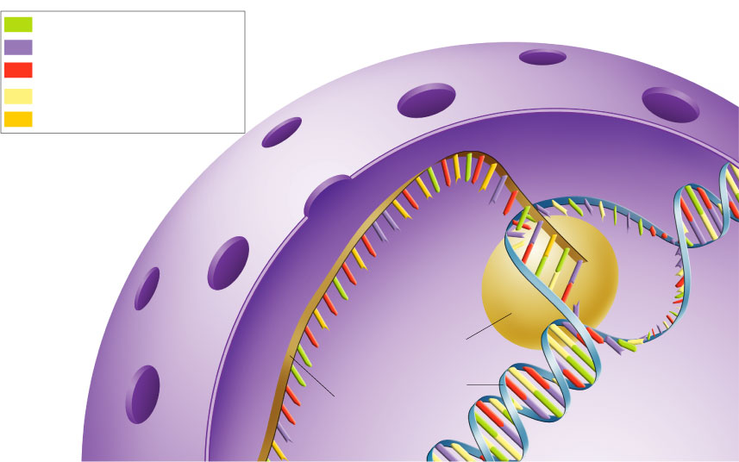
Transcription
12-3
Adenine (DNA and RNA)
Cystosine (DNA and RNA)
Guanine(DNA and RNA)
Thymine (DNA only)
Uracil (RNA only)

Slide 20
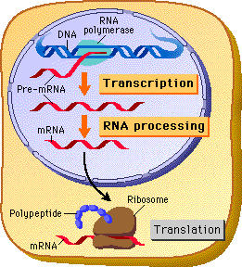
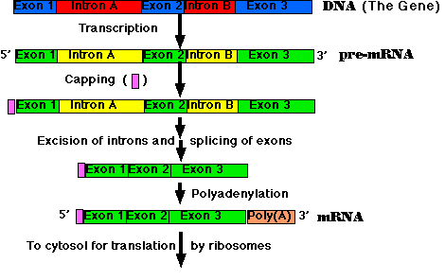
RNA Processing
12-3
Not all information from DNA is necessary
mRNA must be “edited” before protein synthesis
Occurs in nucleus
Introns are useless sequences that are removed
Exons are the remaining segments that actually code for proteins
Spliced together after introns are removed

Slide 21
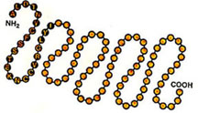
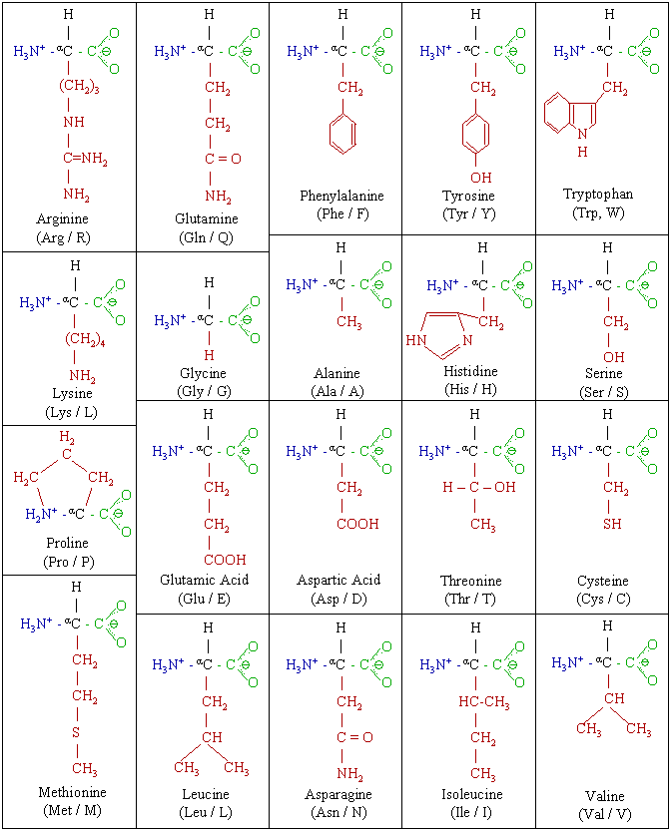
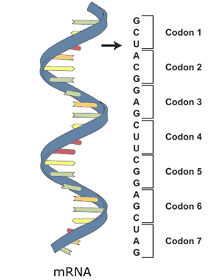
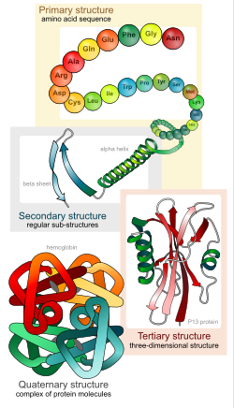
The Genetic Code
12-3
Polypeptides are long chains (polymers) of amino acids
Called proteins when very long or in their final stable form
There are 20 amino acids but only 4 nitrogenous bases
Codons are 3 nucleotide sequences that code for specific amino acids

Slide 22
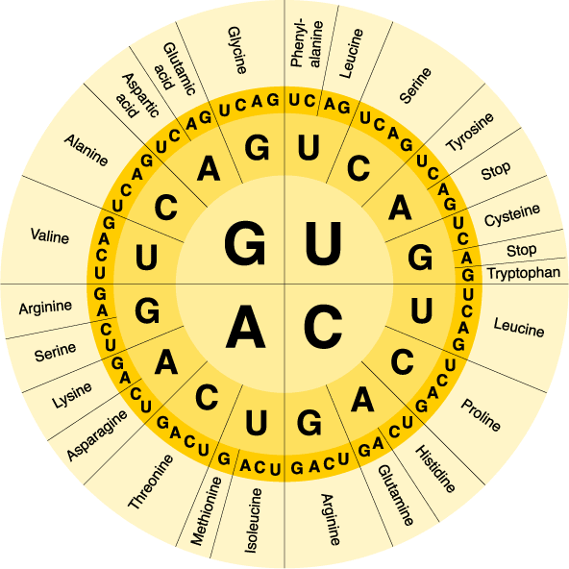
The Genetic Code
12-3
Start
Alanine -
Threonine -
Glutamic acid -
Leucine -
STOP
Arginine -
Serine -

Slide 23
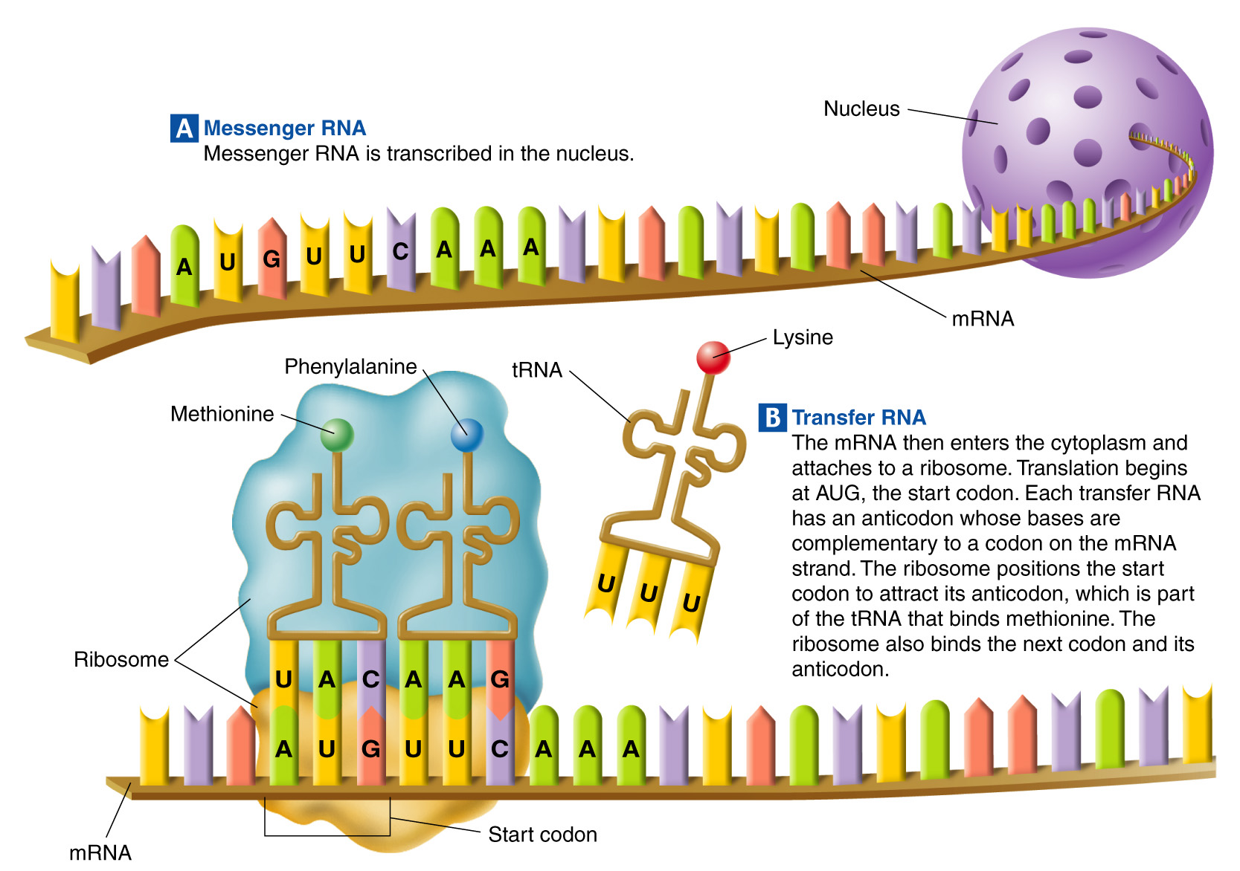
Translation
12-3

Slide 24
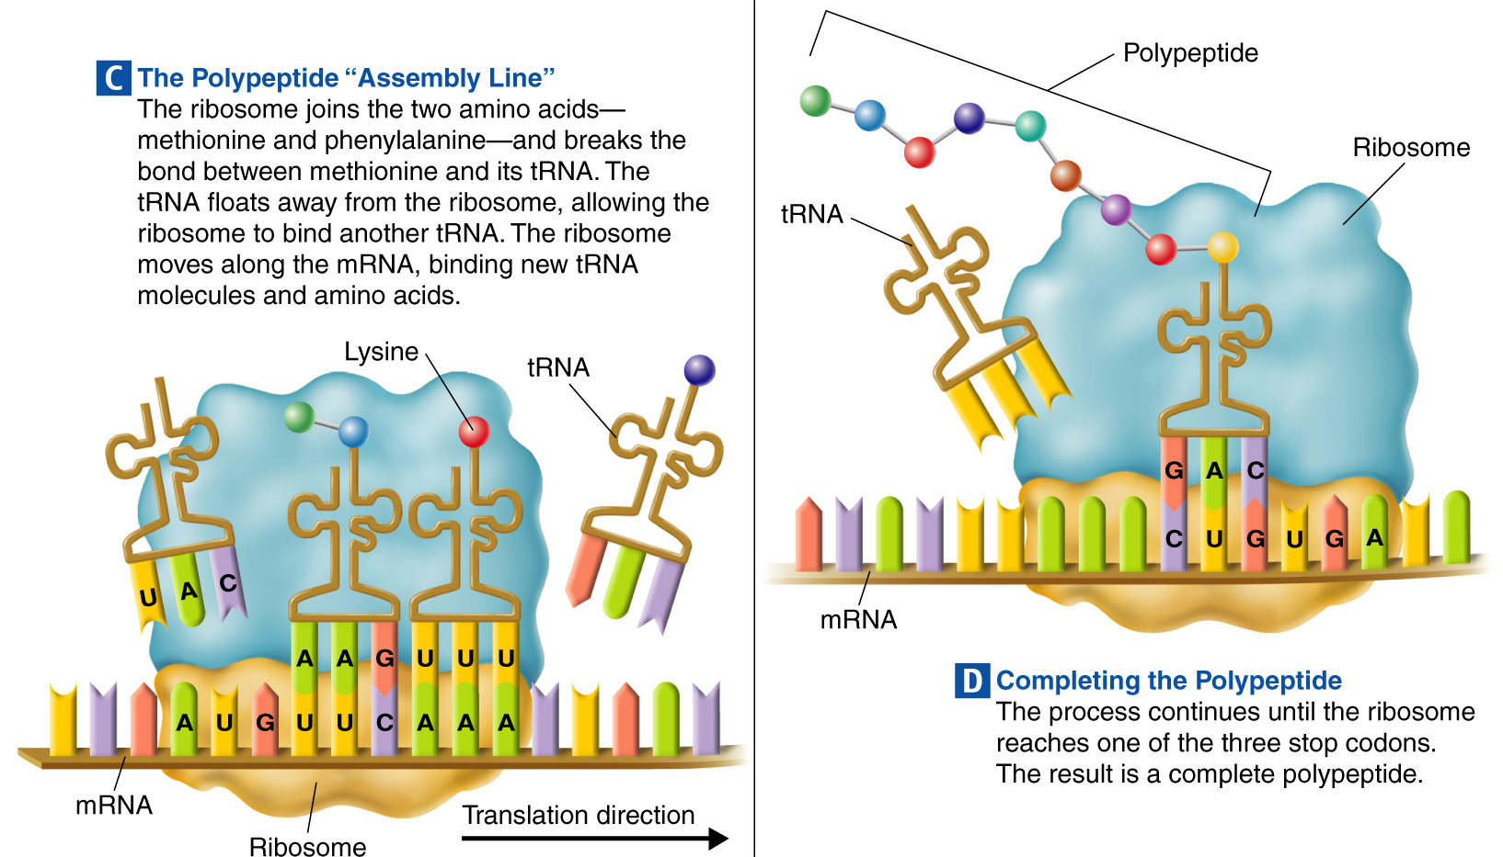
Translation
12-3

Slide 25
Chapter 12-4: Mutations
12-4
Evaluate the severity of various genetic mutations
Objectives:
Explain the difference between gene mutations and chromosomal mutations

Slide 26
Mutations
Gene Mutations
Chromosomal Mutations
Point Mutations
Substitutions
Frameshift Mutations
Insertions
Deletions
Deletion
Duplication
Inversion
Tanslocation

Slide 27
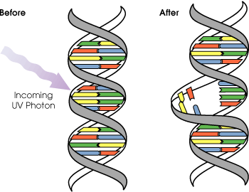
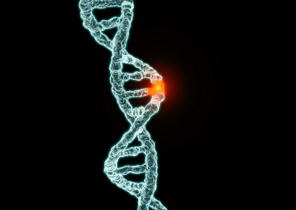
Gene Mutations
12-4
Small DNA changes
One or a few nucleotides
Point mutations occur at a single point in the DNA sequence
3 Types of point mutations:
Substitutions
Deletions
Insertions

Slide 28
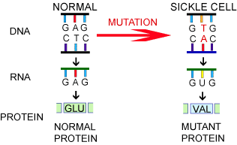
Substitution Mutations
12-4
One nitrogenous base is changed to another
Usually affects only one amino acid
Least harmful mutation
Substitution

Slide 29
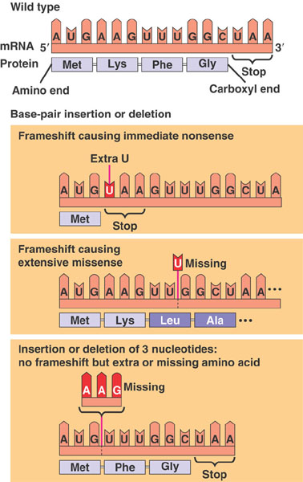
Frameshift Mutations
12-4
Caused by either a deletion or an insertion
Entire “reading frame” is shifted
Multiple amino acids affected
Deletion

Slide 30
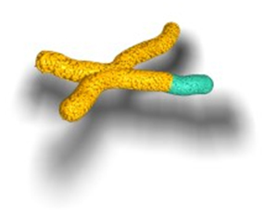
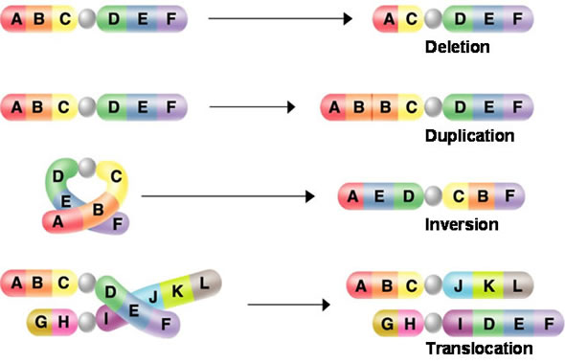
Chromosomal Mutations
12-4
Changes in the number or structure of entire chromosomes
Impacts much more genetic information than gene mutations
Much more severe
4 Types:
Deletion
Duplication
Inversion
Translocation
Original

Slide 31
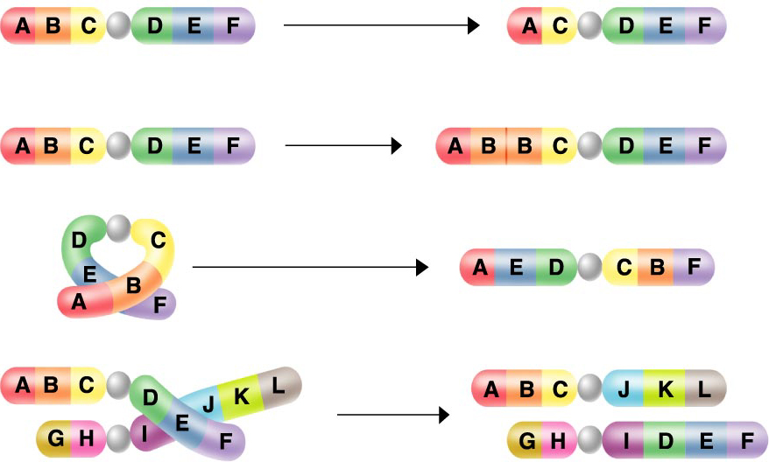
Chromosomal Mutations
12-4
Deletion
Duplication
Inversion
Translocation

Slide 32
Mutations
Gene Mutations
Chromosomal Mutations
Point Mutations
Substitutions
Frameshift Mutations
Insertions
Deletions
Deletion
Duplication
Inversion
Tanslocation

